Slide 1
CSC 3210 Computer Organization and Programming
Lab Work 6
Dr. Zulkar Nine
mnine@gsu.edu
Georgia State University
Spring 2021

Slide 2
Learning Objective
Variable declaration
Data types
Comments
String
DUP operator
Data Transfer, and arithmetic instructions with variables

Slide 3
Disclaimer
The process shown in these slides might not work in every single computer due to Operating system version, Microsoft Visual Studio versions and everything.
If you find any unusual error, you can inform the instructor.
Instructor will help you resolve the issue.

Slide 4
Attendance!

Slide 5
Examples
Don’t need to turn in!

Slide 6
Example 1
Which one of the following is a valid identifier ?
_work_var_1
#work_var_1
_1work_var
?work_var_1

Slide 7
Example 1 Answer
Which one of the following is a valid identifier ?
_work_var_1 (correct)
#work_var_1
_1work_var (correct)
?work_var_1 (correct)

Slide 8
Example 2
.data
VAR word 10
.code
mov var, 15
This code will issue an error, because, identifiers are case sensitive.

Slide 9
Example 2 answer
No errors
Identifiers are NOT case sensitive

Slide 10
Example 3
The following is a valid multi-line comment :
COMMENT !
This is a comment!
This is a comment!
!

Slide 11
Example 3 Answer
Character ‘!’ is invalid, because it is present in the comment.
Choose a character that is not present in the comment

Slide 12
Example 4
Which of the following variable declarations are valid?
Val DW 12
Val SDWORD -12
Val WORD ABCDh

Slide 13
Example 4 answer
Val DW 12 (valid)
Val SDWORD -12. (valid)
Val WORD ABCDh. (NOT Valid)
Correct declaration : var WORD 0ABCDh

Slide 14
Example 5
What is the little endian representation of the following variable
Var DWORD 87654321h
Given that the first address assigned to the variable is 0000.
0000
0001
0002
0003

Slide 15
Example 5 Answer
What is the little endian representation of the following variable
Var DWORD 87654321h
0000
21
43
65
87
0001
0002
0002

Slide 16
Lab Work 6 Instructions
Lab 6(a) : Write a program to evaluate an expression with variables (4 Points)
Lab 6(b): Write a program to see the data items in an array (3 points)
Lab 6(c): Write a program to find the size of the string (3 points)
Due Date: 02/26/21 11:59 PM

Slide 17
Submission Instruction
There is an answer sheet provided with the lab
Fill out the answer sheet and submit it to iCollege.

Slide 18
Lab 6(a)
Submission

Slide 19
Data Transfer and Arithmetic Instructions
Write a program to implement the following expression in assembly:
EAX = Xval - (Yval + Zval)
Xval is signed 32-bit integer variable
Yval and Zval are unsigned 32-bit integer variable
Assign Xval 26, Yval 30, and Zval 40.
How to approach this problem and its solution are provided in the upcoming slides.
Make sure you understand the solution

Slide 20
Data Transfer and Arithmetic (add and sub) Instructions
Before writing a program you should know what an instruction can and can not do
Add and subtract can only do the following:
Add or sub register to/from register:
add eax, ebx
Add or sub register to/from memory:
sub mem1, eax
Add or sub memory to/from register:
sub eax, mem1
Add or subtract immediate to/from memory:
add mem1,3
Add or subtract immediate to/from register:
add eax,3

Slide 21
Data Transfer and Arithmetic (add and sub) Instructions
Before writing a program you should know what an instruction can and can not do
Add and subtract can NOT do the following
Add or sub memory to/from memory:
sub mem1,mem2 or add mem1,mem2
- The same apply for mov instruction

Slide 22
Data Transfer and Arithmetic (add and sub) Instructions
.386
.model flat, stdcall
.stack 4096
ExitProcess PROTO, dwExitCode: DWORD
Create a new Project to run the following program.
Build and run the program using the debugger
Examine the content of the registers
Explain the content of the registers and variables
; EAX = Xval - (Yval + Zval)
.data
Xval SDWORD 26
Yval DWORD 30
Zval DWORD 40
.code
main proc
; second term: (Yval + Zval)
mov ebx,Yval
add ebx,Zval
; sub the terms and store:
sub Xval,ebx
mov eax,Xval
invoke ExitProcess, 0
main ENDP
END main
; parenthesis have higher precedence, do them first

Slide 23
Submission Instruction
There is an answer sheet attached to the lab
Debug through each line of your code.
Execute the instruction
Take a screenshot of the code and register window
Record the line number, instruction, Register values in the answer sheet.
Also add the screenshot
Then explain the register contents.

Slide 24
Lab 6(b)
Submission

Slide 25
Defining Data: Using the DUP Operator
Use DUP to allocate (create space for) an array or string.
Syntax: counter DUP ( argument )
Counter and argument must be constants or constant expressions
var1 BYTE 20 DUP(0) ; 20 bytes, all equal to zero
var2 BYTE 20 DUP(?) ; 20 bytes, uninitialized
var3 BYTE 4 DUP("STACK") ; 20 bytes: "STACKSTACKSTACKSTACK"
var4 BYTE 10,3 DUP(0),20 ; 5 bytes
Notes:
Sec 03 Feb 09

Slide 26
Dup Operator
Create a new application to run the following program.
Build and run the program using the debugger
Examine the content of the register AX
mov ax,myWord+0 ;sum up the list values
add ax, myWord + 2
add ax, myWord + 4
add ax, myWord + 6
add ax, myWord + 8
invoke ExitProcess,0
main endp
end main
; summation of the list values.
.386
.model flat, stdcall
.stack 4096
ExitProcess proto, dwExitCode:dword
.data
myWord word 4 dup(1,2,3,4,5)
.code
main proc
mov eax,0 ; zeroing eax
Note: Section Appendix has a reference to how to create a new project.

Slide 27
Submission Instruction
Debug the code
Answer the questions in the answer sheet.
What is the total size of the myWord array?
Debug the code until the ‘invoke ExitProcess, 0’. Attach screenshot showing the content of AX register at the end.

Slide 28
Lab 6(c)
Submission

Slide 29
$ Operator
Create a new application to run the following program.
Build and run the program using the debugger
Examine the content of the register AL (convert the value to decimal to see length of the string)
; Calculating the size of the String
.386
.model flat, stdcall
.stack 4096
ExitProcess proto, dwExitCode:dword
.data
myString byte "This is a very long string made by your instructor to test how $ works in this lab hope you will like it"
myString_length = ($ - myString)
.code
main proc
mov eax,0
mov al, myString_length
invoke ExitProcess,0
main endp
end main
Note: Section Appendix has a reference to how to create a new project.

Slide 30
Submission Instruction
Debug the code
Answer the questions in the answer sheet.
What is the difference between symbolic constant and variables?
Debug the code until ‘invoke ExitProcess, 0’. Attach the screenshot showing the content of al register at the end.

Slide 31
Appendix
Create a Project

Slide 32
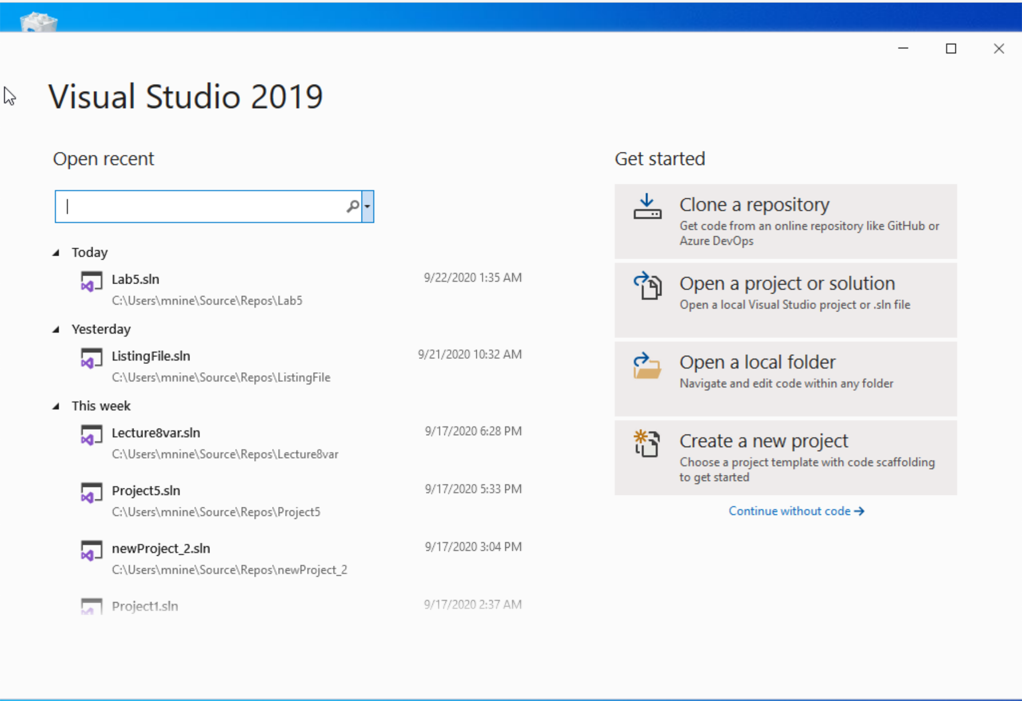


Step 1: Create a project (1)
Start Visual Studio
Click Create a new Project

Slide 33
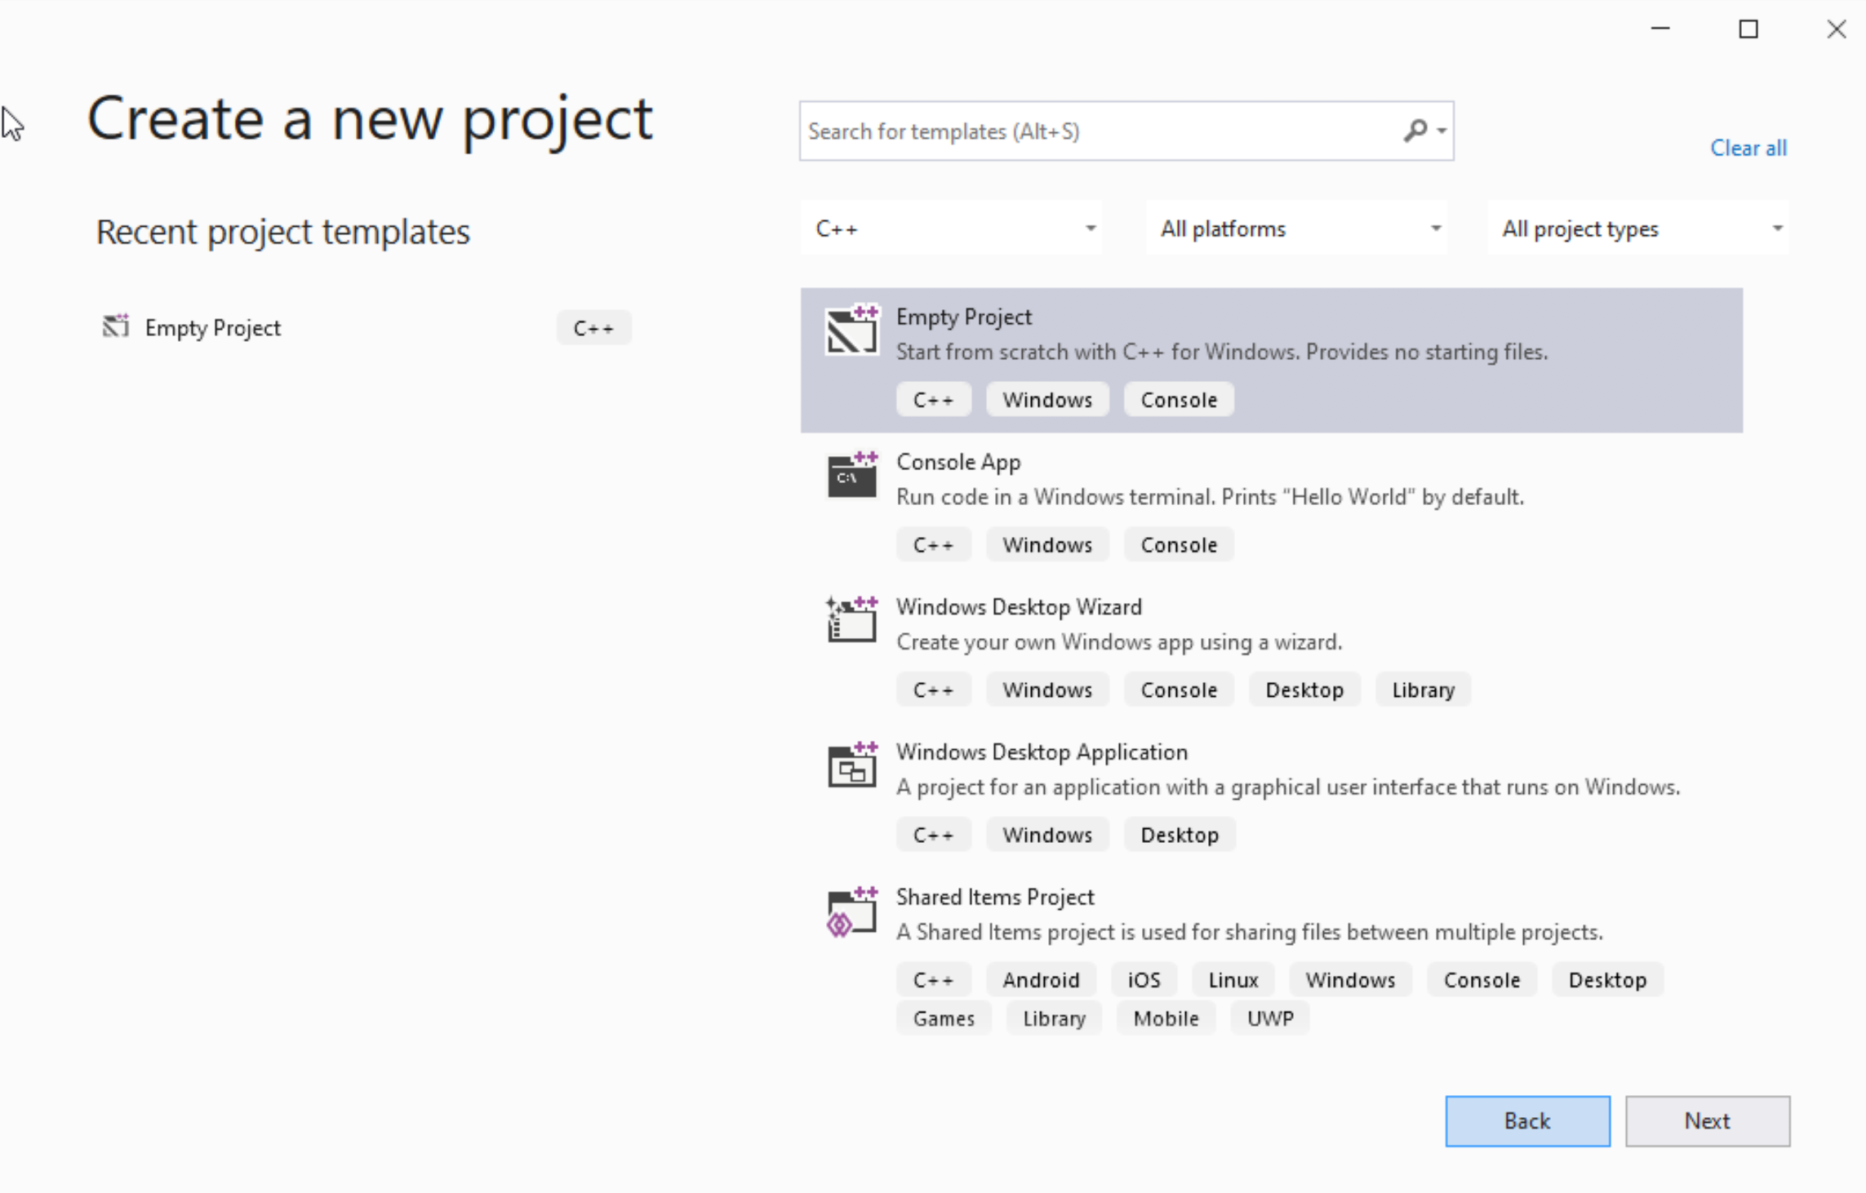




Step 1: Create a project (2)
Select C++ as language
Select Empty Project
Click Next

Slide 34
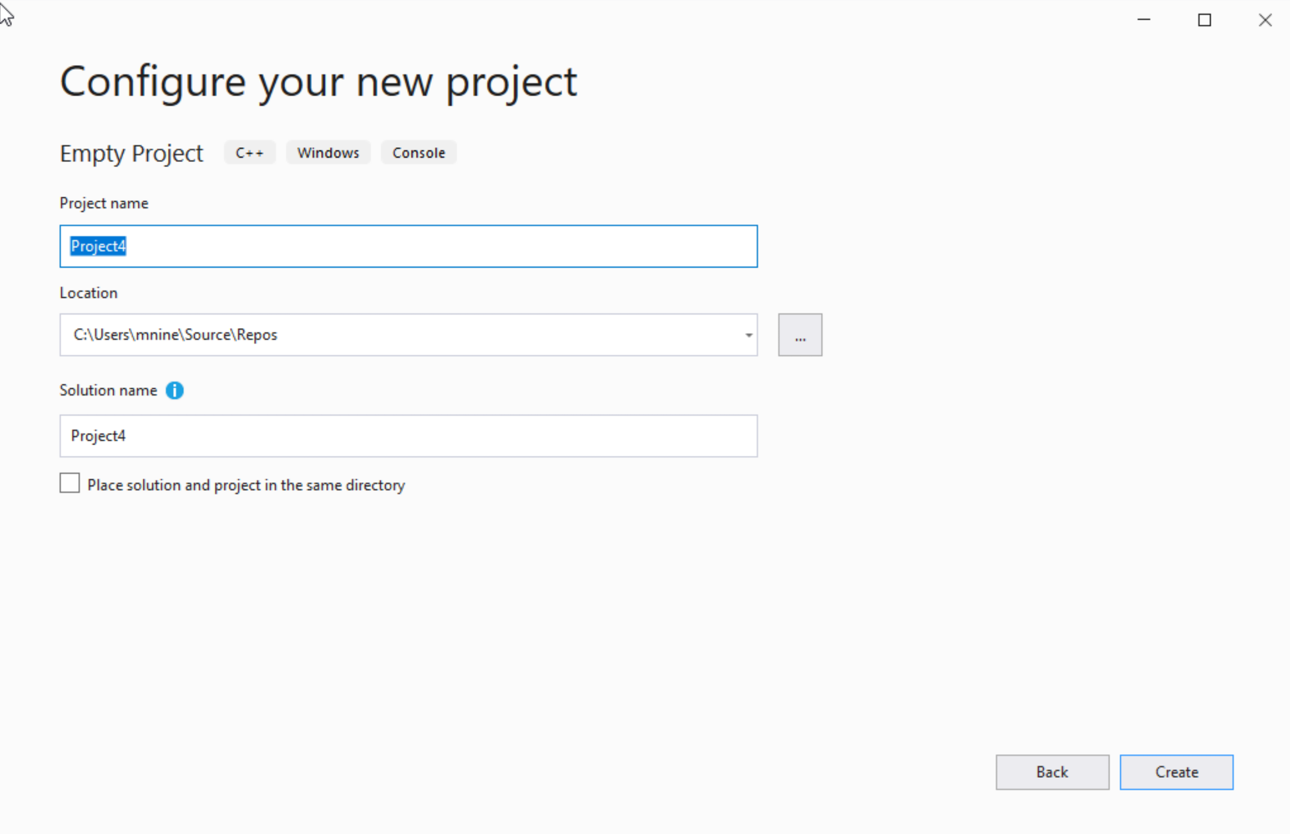

Step 1: Create a project (3)
You can change the project
name as you like
Also, you can change the
project location
Click Next

Slide 35
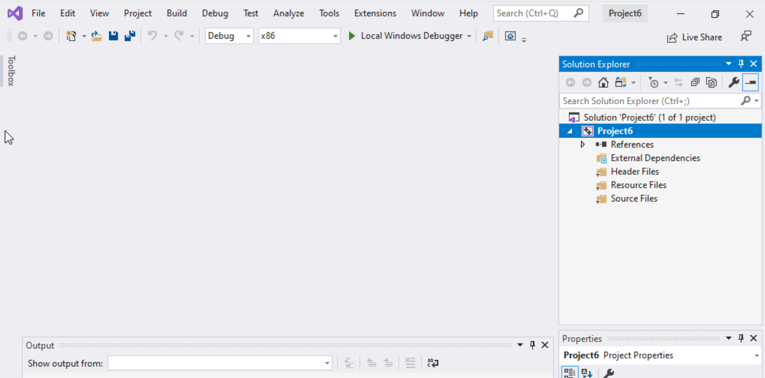
Step 1: Create a project (4)
Delete the
Following folders:
Header files
Resources Files, and
Source Files

Slide 36
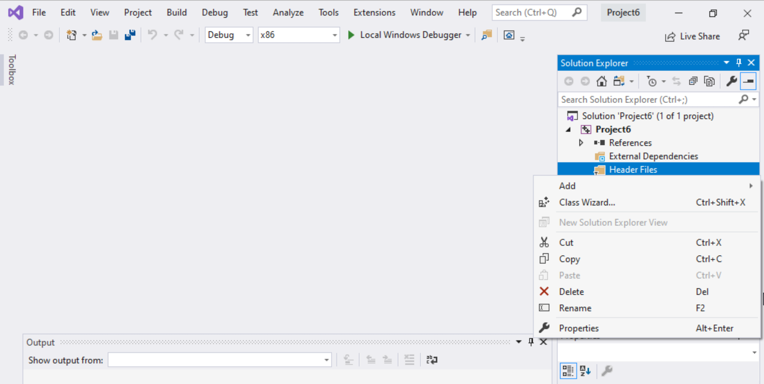
Step 1: Create a project (5)
To delete :
Select the folders
Right click on it
Select delete

Slide 37
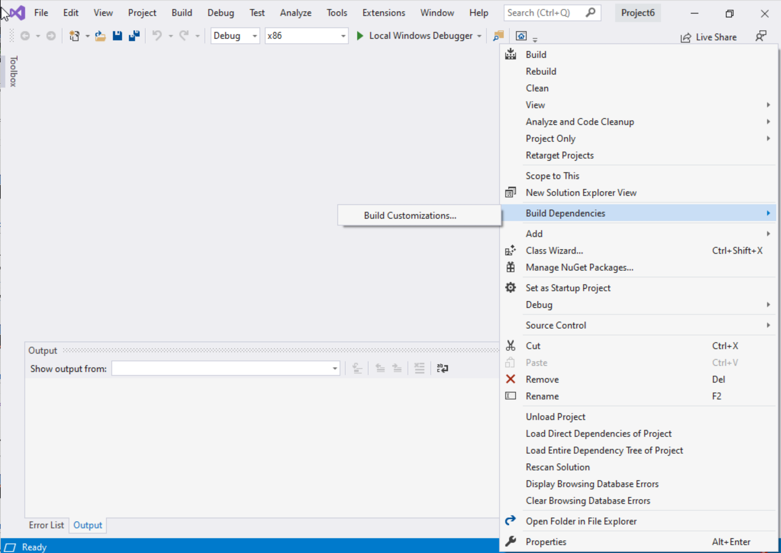
Step 1: Create a project (6)
Select Project Name on solution explorer
Right click on it
Go to Build Dependencies
Click on Build Customizations

Slide 38
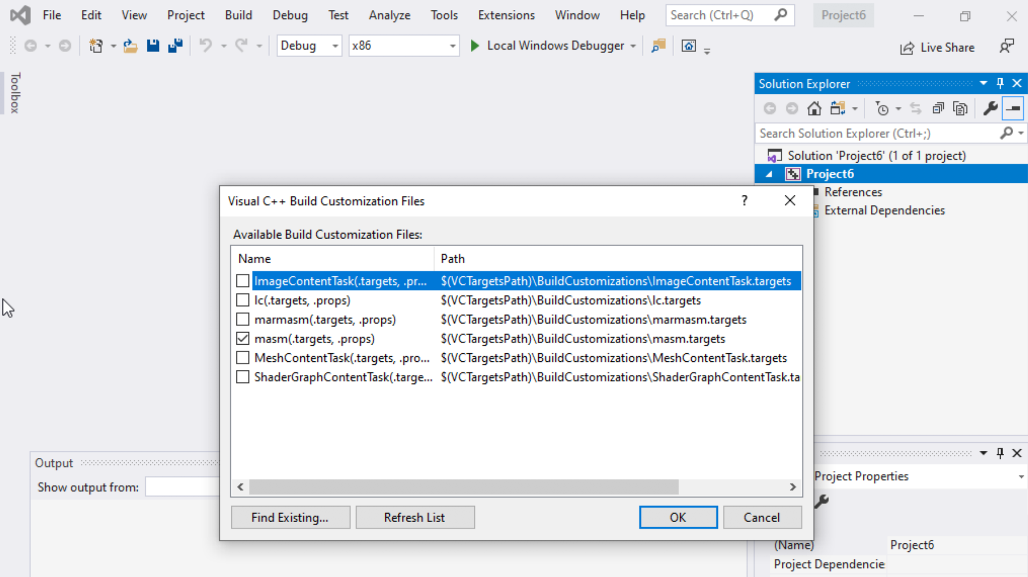
Step 1: Create a project (7)
Select masm(.target, .props)
Click ok

Slide 39
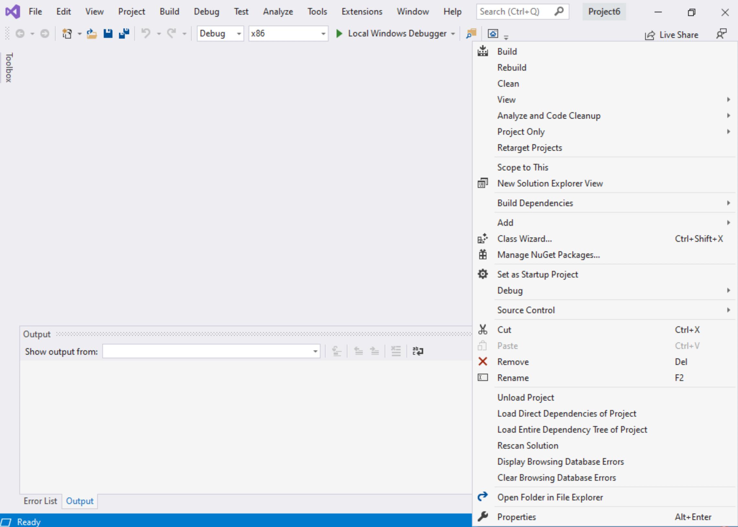
Step 1: Create a project (8)
Right click on the Project name in the solution explorer
Click properties

Slide 40
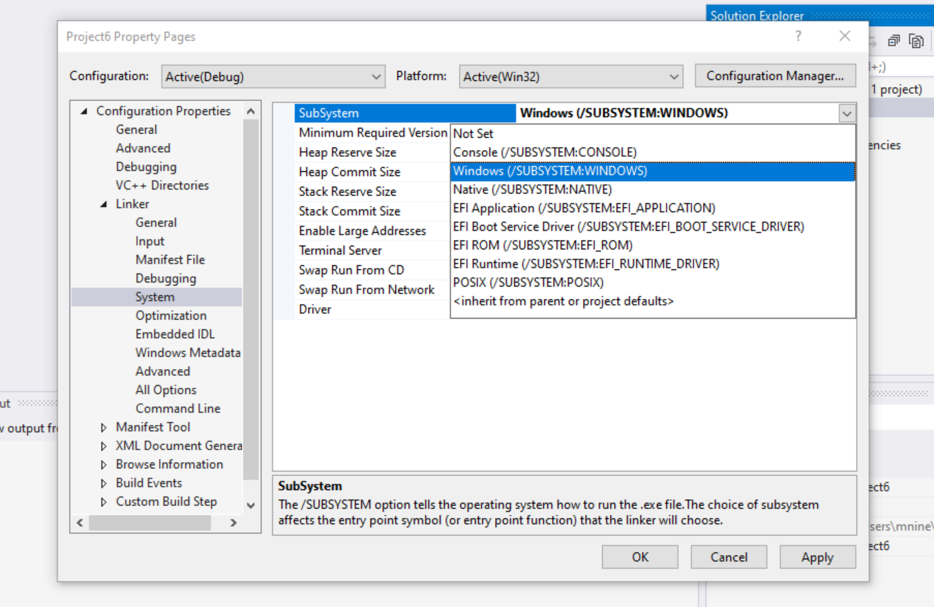

Step 1: Create a project (9)
Expand the ‘Linker’
Select ’System’
Select Windows(/SUBSYSTEM:WINDOWS)
Click OK

Slide 41
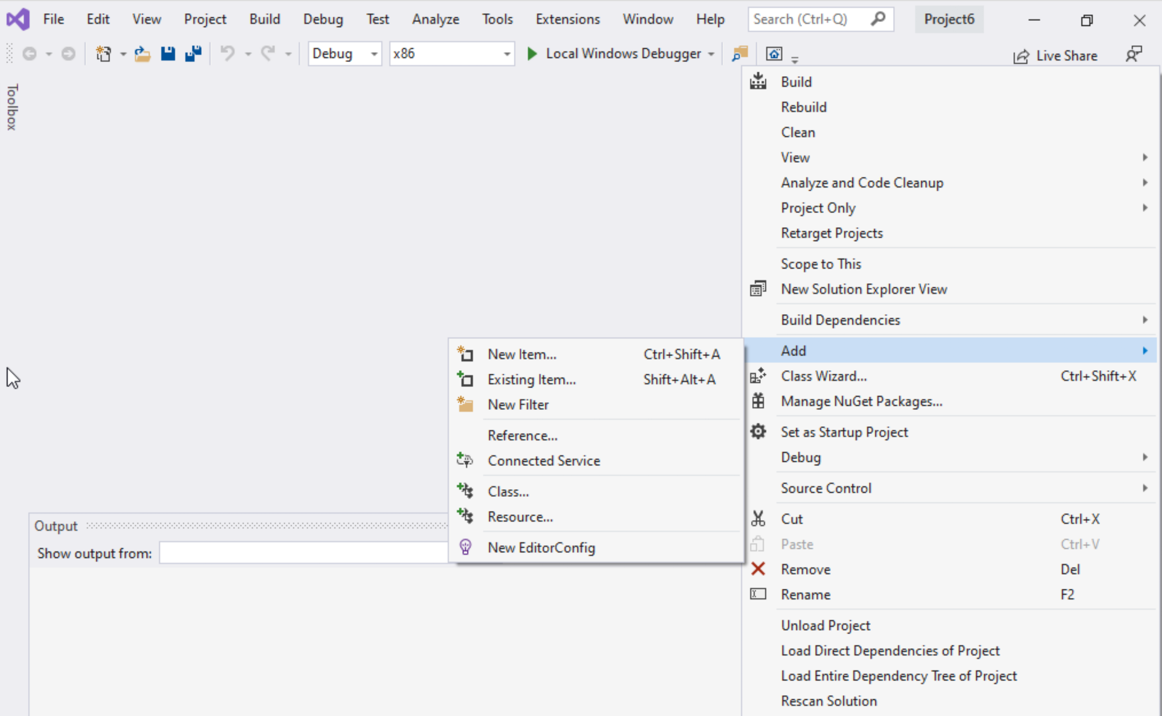
Step 1: Create a project (10)
Select Project name on solution explorer
Right click on it
Expand Add
Choose New Item

Slide 42
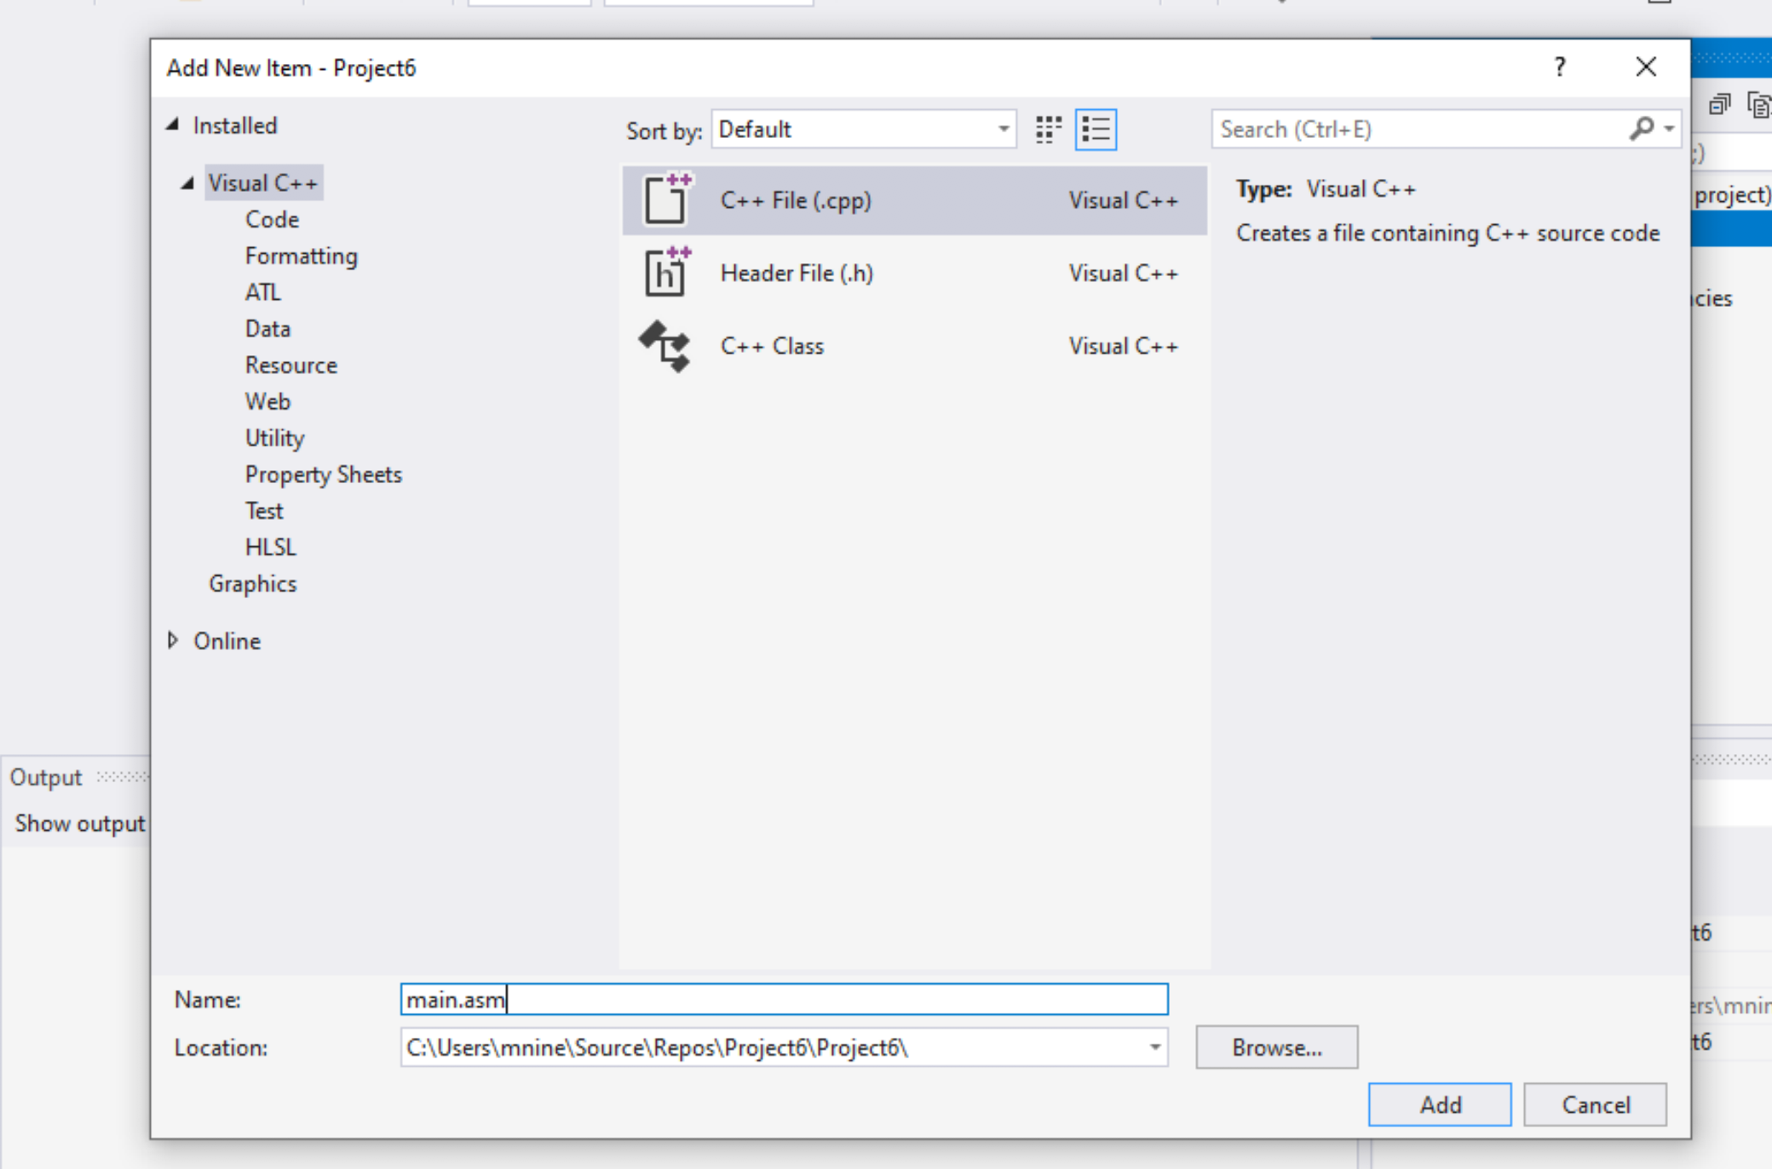


Step 1: Create a project (11)
Select C++ File(.cpp)
Name: main.asm
Click Add

Slide 43
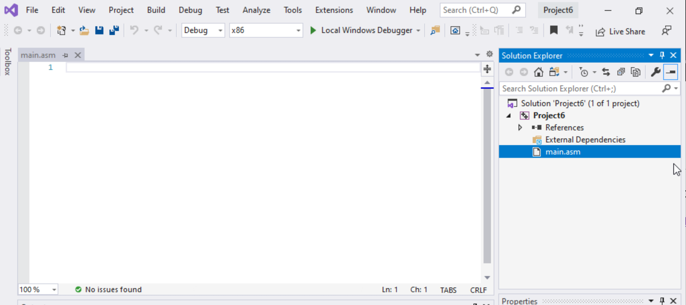

Step 1: Create a project (12)
Select main.asm
Add your code
In the main.asm File.

